Slide 1
SIMPLE INTELLIGENT AI CHATBOT
Subject: Naan Mudhalvan
Name: Nandhini V M
Institute: Madras Institute of Technology
Department: Computer Science

Slide 2
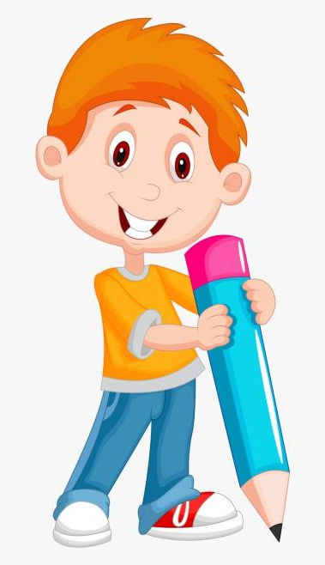

OVERVIEW
PROBLEM STATEMENT
OBJECTIVES
PROPOSED SYSTEM / SOLUTION
SYSTEM APPROACH
ALGORITHM AND DEPLOYMENT
IMPLEMENTATION
RESULT
CONCLUSION
3/21/2024 Annual Review

Slide 3

PROBLEM STATEMENT
Develop a simple Intelligent AI chatbot using the Natural Language Toolkit (NLTK) library in Python to address the increasing demand for automated conversational agents across various domains such as customer service, education, and entertainment. The chatbot should be capable of understanding and responding to user queries by employing techniques such as tokenization, lemmatization, and bag-of-words model. Additionally, the project aims to demonstrate the training process of the chatbot using predefined intents and responses stored in JSON format, as well as the implementation of saving and loading the trained model using pickle. This project seeks to provide a foundational guide for individuals interested in building and comprehending the functionality of chatbots using NLTK in Python.

Slide 4
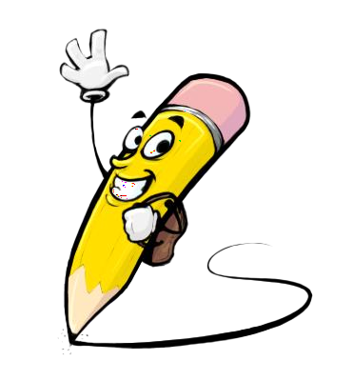
OBJECTIVES
Development of a Simple Chatbot:
Implement a basic chatbot using NLTK in Python to enable automated interaction with users.
Utilization of Natural Language Processing Techniques:
Employ tokenization, lemmatization, and removal of punctuation to preprocess user input for effective understanding.
Training and Model Management:
Train the chatbot using predefined intents and responses stored in JSON format, and demonstrate the saving and loading of the trained model using pickle for reusability

Slide 5

PROPOSED SYSTEM/ SOLUTION
NLTK-Based Chatbot: A Proposed System Solution
The proposed system solution involves the development of a chatbot using the Natural Language Toolkit (NLTK) in Python. The chatbot will utilize NLTK's powerful natural language processing (NLP) capabilities to understand and respond to user queries. It will employ techniques such as tokenization, lemmatization, and removal of punctuation to preprocess user input. The chatbot will be trained using a predefined set of intents and responses stored in JSON format, and the trained model will be saved and loaded using pickle for efficient management. This solution aims to provide a simple yet effective conversational agent that can be deployed across various domains for tasks such as customer service, education, and entertainment.

Slide 6
SYSTEM APPROACH
HARDWARE REQUIREMENTS:
Standard laptop / computer
Memory
Internet Connection
Storage

Slide 7
SYSTEM APPROACH
SOFTWARE REQUIREMENTS:
Python
TensorFlow
NLTK (Natural Language Toolkit)
JSON Library
Pickle Library
Keras
Jupyter Notebook

Slide 8
ALGORITHM AND DEPLOYMENT
1.Initialization:
Import necessary libraries: NLTK, JSON, Pickle.
Load and preprocess the predefined intents and responses from a JSON file.
Initialize NLTK for tokenization, lemmatization, and other NLP tasks.
2 .Preprocessing:
Tokenization: Split user input into individual words or tokens.
Lemmatization: Reduce words to their base or root form for better understanding.
Remove punctuation: Eliminate punctuation marks from the input.
3.Bag-of-Words Model:
Represent user input and predefined intents as numerical vectors using the bag-of-words model.
Determine the similarity between user input and each predefined intent.
4.Intent Recognition:
Identify the intent with the highest similarity score.
Retrieve the corresponding response associated with the recognized intent.
5.Response Generation:
Generate an appropriate response based on the recognized intent.
Return the response to the user.
6.Training:
Train the chatbot using the predefined intents and responses.
Save the trained model using Pickle for future use.

Slide 9
ALGORITHM AND DEPLOYMENT
Deployment:
Develop the chatbot logic incorporating natural language understanding and response generation.
Create a user-friendly interface for interacting with the chatbot, choosing between web-based or command-line interfaces.
Evaluate deployment options such as local servers, cloud platforms, or containerized environments.
Deploy the chatbot on the chosen platform, ensuring all dependencies are installed and configurations are set up correctly.
Conduct thorough testing to verify functionality and performance, and implement monitoring mechanisms for ongoing maintenance.

Slide 10
IMPLEMENTATION
1.Setup and Preprocessing:
Load necessary libraries such as NLTK and TensorFlow.
Preprocess the data: Load intents and responses from a JSON file, and prepare the input data for training.
2.Model Training and Integration:
Train an LSTM model using the preprocessed data to classify user intents.
Integrate the trained model into the chatbot system for real-time inference and response generation.
3.User Interface and Deployment:
Develop a user-friendly interface for users to interact with the chatbot, using technologies like Flask for web applications or a command-line interface for local applications.
Deploy the chatbot system on a chosen platform, such as a local server, cloud server, or containerized environment, ensuring all dependencies are met for seamless operation.

Slide 11
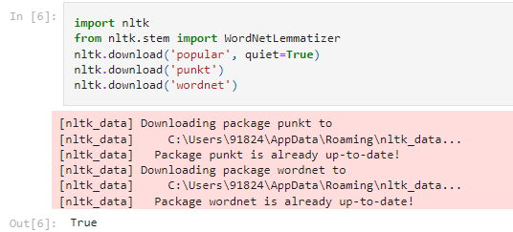

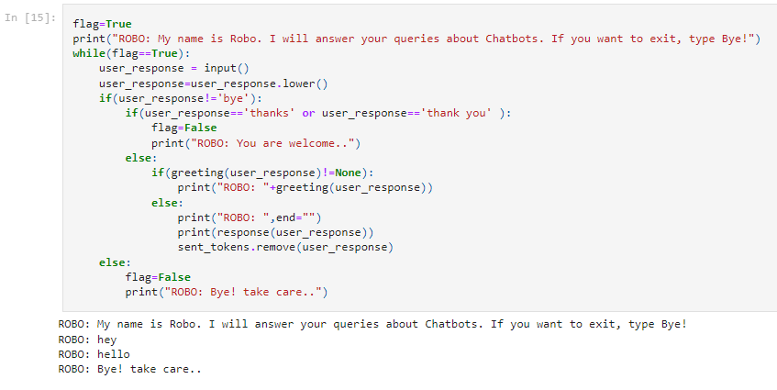
RESULT
Output:
https://github.com/84Nan/NM_GenAI-project/blob/main/_chatbot%20(1).ipynb

Slide 12

CONCLUSION
This project illustrates the creation of a basic chatbot using Python's NLTK library. Chatbots have gained prominence in various sectors like customer service and education. NLTK, renowned for its natural language processing tools, provides the foundation for implementing rudimentary chatbot functionality. The chatbot employs tokenization, lemmatization, and punctuation removal to preprocess user input, while a bag-of-words model facilitates understanding and responding to queries. Training the chatbot on predefined intents and responses stored in JSON format enables seamless interaction. Additionally, the project highlights the importance of model persistence, demonstrated through saving and loading the trained model using pickle. Ultimately, this project serves as an introductory guide to building and comprehending simple chatbots using NLTK in Python.
3/21/2024 Annual Review

Slide 13
THANK YOU ☺

